Slide 1
Multi Modal System
Example sketch & plot

Slide 2



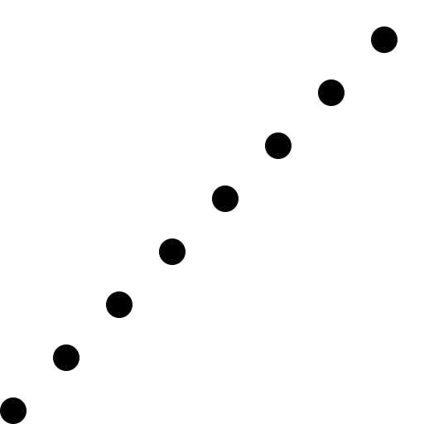



#1 Truck/ #1 Drone
8
1
7
6
5
3
9
4
2
10
Depot(0)

Slide 3
#1 Truck/ #1 Drone [scenario ver.1]
Only Truck opt
(initial)
0 | 2 | 3 | 5 | 8 | 7 | 6 | 1 | 9 | 4 | 10 | 0
3
1
Drone’s SERVICE NODE
Drone’s sub routes
2 | 3 | 8
2
8
6
9
Drone’s FLY/CATCH NODE
6 | 1 | 9
0 | 2 | 3 | 5 | 8 | 7 | 6 | 1 | 9 | 4 | 10 | 0
2 | 3 | 5 | 8
6 | 1 | 9
sub routes
4 : ONLY Truck
3 : CATCH(both)
2 : ONLY Drone
1 : FLY (both)
0 : IDLE (both)
0 | 2 | 3 | 5 | 8 | 7 | 6 | 1 | 9 | 4 | 10 | 0
0 | 1 | 2 | 4 | 3 | 0 | 1 | 2 | 3 | 0 | 0 | 0

Slide 4
#1 Truck/ #1 Drone
Truck’s route
Except node with element 2
(ONLY Drone)
0 | 2 | 5 | 8 | 7 | 6 | 9 | 4 | 10 | 0
0 | 2 | 5 | 8 | 7 | 6 | 9 | 4 | 10 | 0
0 | 1 | 4 | 3 | 0 | 1 | 3 | 0 | 0 | 0
Drone’s route
Except node with element 4
(ONLY Truck)
0 | 2 | 3 | 8 | 7 | 6 | 1 | 9 | 4 | 10 | 0
0 | 2 | 3 | 8 | 7 | 6 | 1 | 9 | 4 | 10 | 0
0 | 1 | 2 | 3 | 0 | 1 | 2 | 3 | 0 | 0 | 0
4 : ONLY Truck
3 : CATCH(both)
2 : ONLY Drone
1 : FLY (both)
0 : IDLE (both)

Slide 5
#1 Truck/ #1 Drone
Catch after drone’s first flight
Truck’s route
0 | 2 | 5 | 8 | 7 | 6 | 9 | 4 | 10 | 0
Charging to drone
Charging to drone
Discharging
(drive & drone charging)
0 | 2 | 3 | 8 | 7 | 6 | 1 | 9 | 4 | 10 | 0
0 | 1 | 2 | 3 | 0 | 1 | 2 | 3 | 0 | 0 | 0
Drone’s route
Discharging
(fly)
Charging
(catch-idle)
Discharging
(flying)
Charging
(catch-idle)
4 : ONLY Truck
3 : CATCH(both)
2 : ONLY Drone
1 : FLY (both)
0 : IDLE (both)

Slide 6
#1 Truck/ #1 Drone [scenario ver.2]
Only Truck opt
(initial)
0 | 2 | 3 | 5 | 8 | 7 | 6 | 1 | 9 | 4 | 10 | 0
3
1
Drone’s SERVICE NODE
Drone’s sub routes
2 | 3 | 8
2
8
8
9
Drone’s FLY/CATCH NODE
8 | 1 | 9
!!! CATCH & FLY !!!
0 | 2 | 3 | 5 | 8 | 7 | 6 | 1 | 9 | 4 | 10 | 0
2 | 3 | 5 | 8
8 | 7 | 6 | 1 | 9
sub routes
5 : FLY&CATCH(both)
4 : ONLY Truck
3 : CATCH(both)
2 : ONLY Drone
1 : FLY (both)
0 : IDLE (both)
0 | 2 | 3 | 5 | 8 | 7 | 6 | 1 | 9 | 4 | 10 | 0
0 | 1 | 2 | 4 | 3/1 | 4 | 4 | 2 | 3 | 0 | 0 | 0
1 – giving priority/overwrite

Slide 7
#1 Truck/ #1 Drone
0 | 2 | 3 | 5 | 8 | 7 | 6 | 1 | 9 | 4 | 10 | 0
0 | 1 | 2 | 4 | 1 | 4 | 4 | 2 | 3 | 0 | 0 | 0
Truck’s route
Except node with element 2
(ONLY Drone)
0 | 2 | 5 | 8 | 7 | 6 | 9 | 4 | 10 | 0
0 | 2 | 5 | 8 | 7 | 6 | 9 | 4 | 10 | 0
0 | 1 | 4 | 1 | 4 | 4 | 3 | 0 | 0 | 0
Drone’s route
Except node with element 4
(ONLY Truck)
0 | 2 | 3 | 8 | 1 | 9 | 4 | 10 | 0
0 | 2 | 3 | 8 | 1 | 9 | 4 | 10
0 | 1 | 2 | 1 | 2 | 3 | 0 | 0
4 : ONLY Truck
3 : CATCH(both)
2 : ONLY Drone
1 : FLY (both)
0 : IDLE (both)
EDGE for objective cost
start:1 ~ end:3
EDGE for charging
Start:3 ~ end:1 or depot

Slide 8
#1 Truck/ #1 Drone
Only Truck opt
(initial)
0 | 2 | 3 | 5 | 8 | 7 | 6 | 1 | 9 | 4 | 10 | 0
5
8
Drone’s SERVICE NODE
Drone’s sub routes
2 | 5 | 8 | 6
2
6
Drone’s FLY/CATCH NODE
0 | 2 | 3 | 5 | 8 | 7 | 6 | 1 | 9 | 4 | 10 | 0
2 | 3 | 5 | 8 | 7 | 6
sub routes
4 : ONLY Truck
3 : CATCH(both)
2 : ONLY Drone
1 : FLY (both)
0 : IDLE (both)
0 | 2 | 3 | 5 | 8 | 7 | 6 | 1 | 9 | 4 | 10 | 0
0 | 1 | 4 | 2 | 2 | 4 | 3 | 0 | 0 | 0 | 0 | 0

Slide 9
#1 Truck/ #1 Drone
0 | 2 | 3 | 5 | 8 | 7 | 6 | 1 | 9 | 4 | 10 | 0
0 | 1 | 4 | 2 | 2 | 4 | 3 | 0 | 0 | 0 | 0 | 0
Truck’s route
Except node with element 2
(ONLY Drone)
0 | 2 | 3 | 7 | 6 | 1 | 9 | 4 | 10 | 0
0 | 2 | 3 | 7 | 6 | 1 | 9 | 4 | 10 | 0
0 | 1 | 4 | 4 | 3 | 0 | 0 | 0 | 0 | 0
Drone’s route
Except node with element 4
(ONLY Truck)
0 | 2 | 5 | 8 | 6 | 1 | 9 | 4 | 10 | 0
0 | 2 | 5 | 8 | 6 | 1 | 9 | 4 | 10 | 0
0 | 1 | 2 | 2 | 3 | 0 | 0 | 0 | 0 | 0
4 : ONLY Truck
3 : CATCH(both)
2 : ONLY Drone
1 : FLY (both)
0 : IDLE (both)
EDGE for objective cost
start:1 ~ end:3
EDGE for charging
Start:3 ~ end:1 or depot

Slide 10
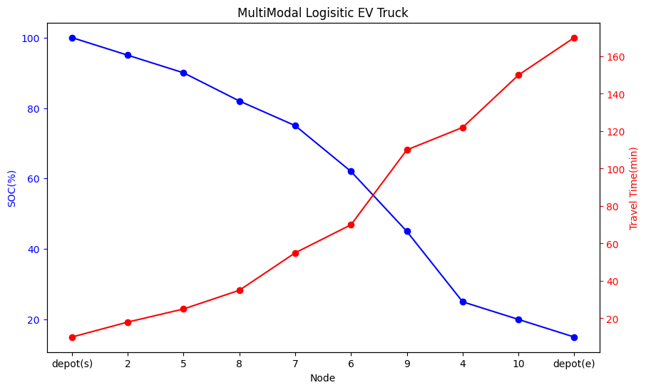
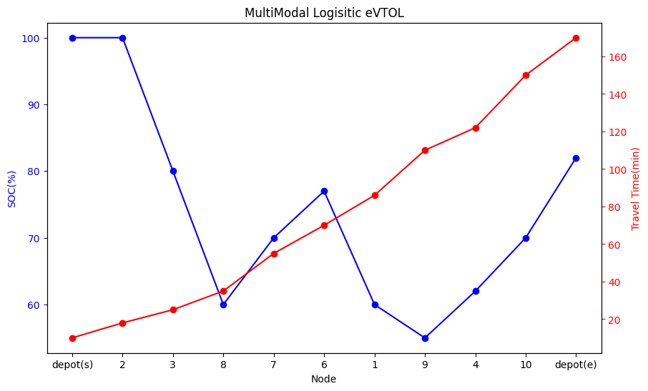

#1 Truck/ #1 Drone
SOC(%) / Travel time(min)
0 | 2 | 5 | 8 | 7 | 6 | 9 | 4 | 10 | 0
0 | 2 | 3 | 8 | 7 | 6 | 1 | 9 | 4 | 10 | 0
Truck’s route
Drone’s route

Slide 11
#m Truck/ #m Drone
8
7
1
6
5
3
9
4
2
10
Depot(0)

Slide 12
#m Truck/ #m Drone
No.1 Only Truck opt
(initial)
No.2 Only Truck opt
(initial)
0 | 2 | 3 | 8 | 5 | 0
0 | 10 | 4 | 9 | 1 | 6 | 7 | 0
3
Drone’s SERVICE NODE
1
Drone’s SERVICE NODE
2
8
Drone’s FLY/CATCH NODE
9
6
Drone’s FLY/CATCH NODE
0 | 2 | 3 | 8 | 5 | 0
0 | 10 | 4 | 9 | 1 | 6 | 7 | 0
0 | 2 | 3 | 8 | 5 | 0
0 | 1 | 2 | 3 | 0 | 0
0 | 10 | 4 | 9 | 1 | 6 | 7 | 0
0 | 0 | 0 | 1 | 2 | 3 | 0 | 0
4 : ONLY Truck
3 : CATCH(both)
2 : SERVICE(only drone)
1 : FLY (both)
0 : IDLE (both)

Slide 13
#m Truck/ #m Drone
0 | 2 | 3 | 8 | 5 | 0
0 | 1 | 2 | 3 | 0 | 0
0 | 10 | 4 | 9 | 1 | 6 | 7 | 0
0 | 0 | 0 | 1 | 2 | 3 | 0 | 0
No.1
Truck’s route
Catch after drone’s first flight
No.2
Truck’s route
Catch after drone’s first flight
0 | 2 | 8 | 5 | 0
0 | 10 | 4 | 9 | 6 | 7 | 0
Charging to drone
Charging to drone
Discharging
(drive & drone charging)
Discharging
(drive & drone charging)
No.1
Drone’s route
No.2
Drone’s route
0 | 2 | 3 | 8 | 5 | 0
0 | 1 | 2 | 3 | 0 | 0
0 | 10 | 4 | 9 | 1 | 6 | 7 | 0
0 | 0 | 0 | 1 | 2 | 3 | 0 | 0
Discharging
(fly)
Charging
(catch-idle)
Discharging
(fly)
Charging
(catch-idle)

Slide 14
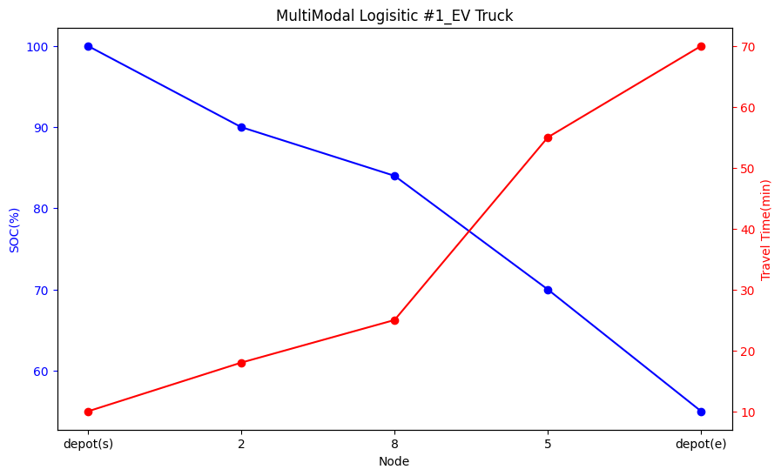
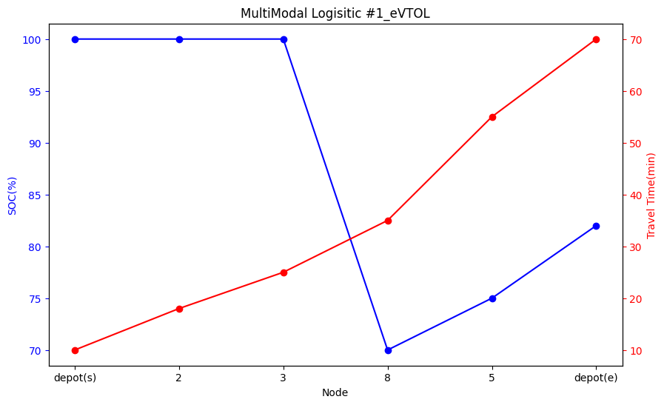
#m Truck/ #m Drone
NO.1 Truck / Drone
SOC(%) / Travel time(min)
0 | 2 | 8 | 5 | 0
0 | 2 | 3 | 8 | 5 | 0
No.1 Truck’s route
No.1 Drone’s route

Slide 15
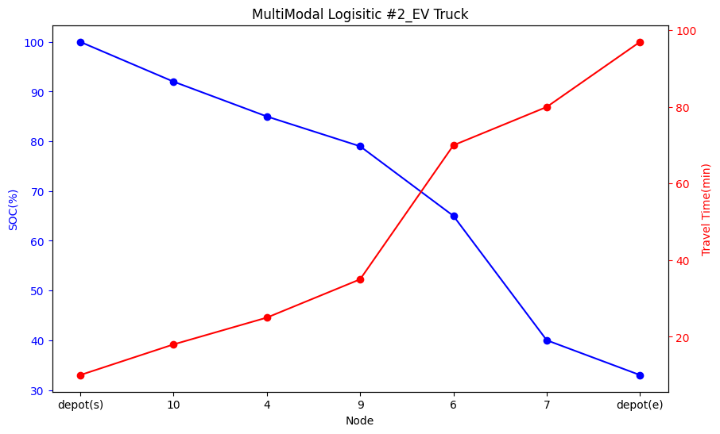
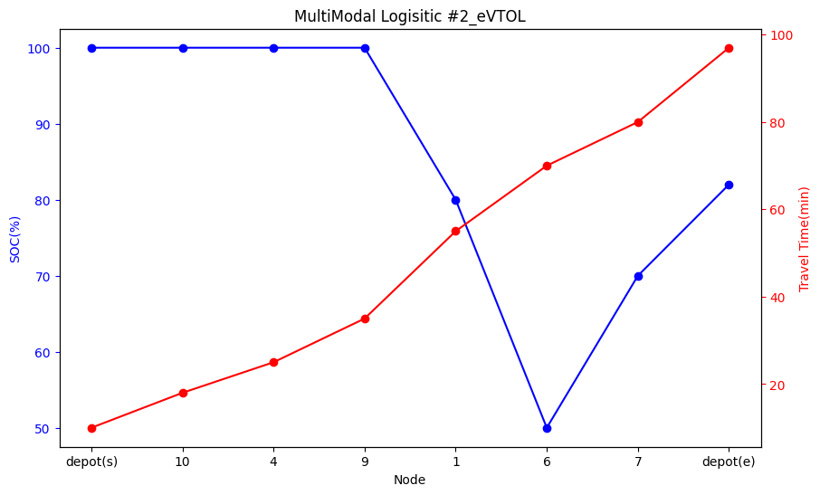
#m Truck/ #m Drone
NO.2 Truck / Drone
SOC(%) / Travel time(min)
0 | 10 | 4 | 9 | 6 | 7 | 0
0 | 10 | 4 | 9 | 1 | 6 | 7 | 0
No.2 Truck’s route
No.2 Drone’s route

Slide 16
Graph Plot Code
https://colab.research.google.com/drive/1sUOFN2WA3FnEXSc3DlFxTnZR3MV8bQIF?usp=sharing

Slide 17
<Route data structure for solution CLASS>
routes = {pair_routes1, pair_routes2 …}
key
key
pair_routes1 =
[
{‘vtype': 'truck’, … , ‘vid': ‘xxx1', ‘path’: [0, 2, 5, 8, 7, 6, 9, 4, 10, 0]},
{‘vtype': 'drone’, … , ‘vid’: ‘xxx2', ‘path’: [0, 2, 3, 8, 7, 6, 1, 9, 4, 10, 0]}
]
value
dictionary
0 | 2 | 5 | 8 | 7 | 6 | 9 | 4 | 10 | 0
0 | 1 | 4 | 3 | 0 | 1 | 3 | 0 | 0 | 0
dictionary
path
0 | 2 | 3 | 8 | 7 | 6 | 1 | 9 | 4 | 10 | 0
0 | 1 | 2 | 3 | 0 | 1 | 2 | 3 | 0 | 0 | 0
tuple

